Slide 1
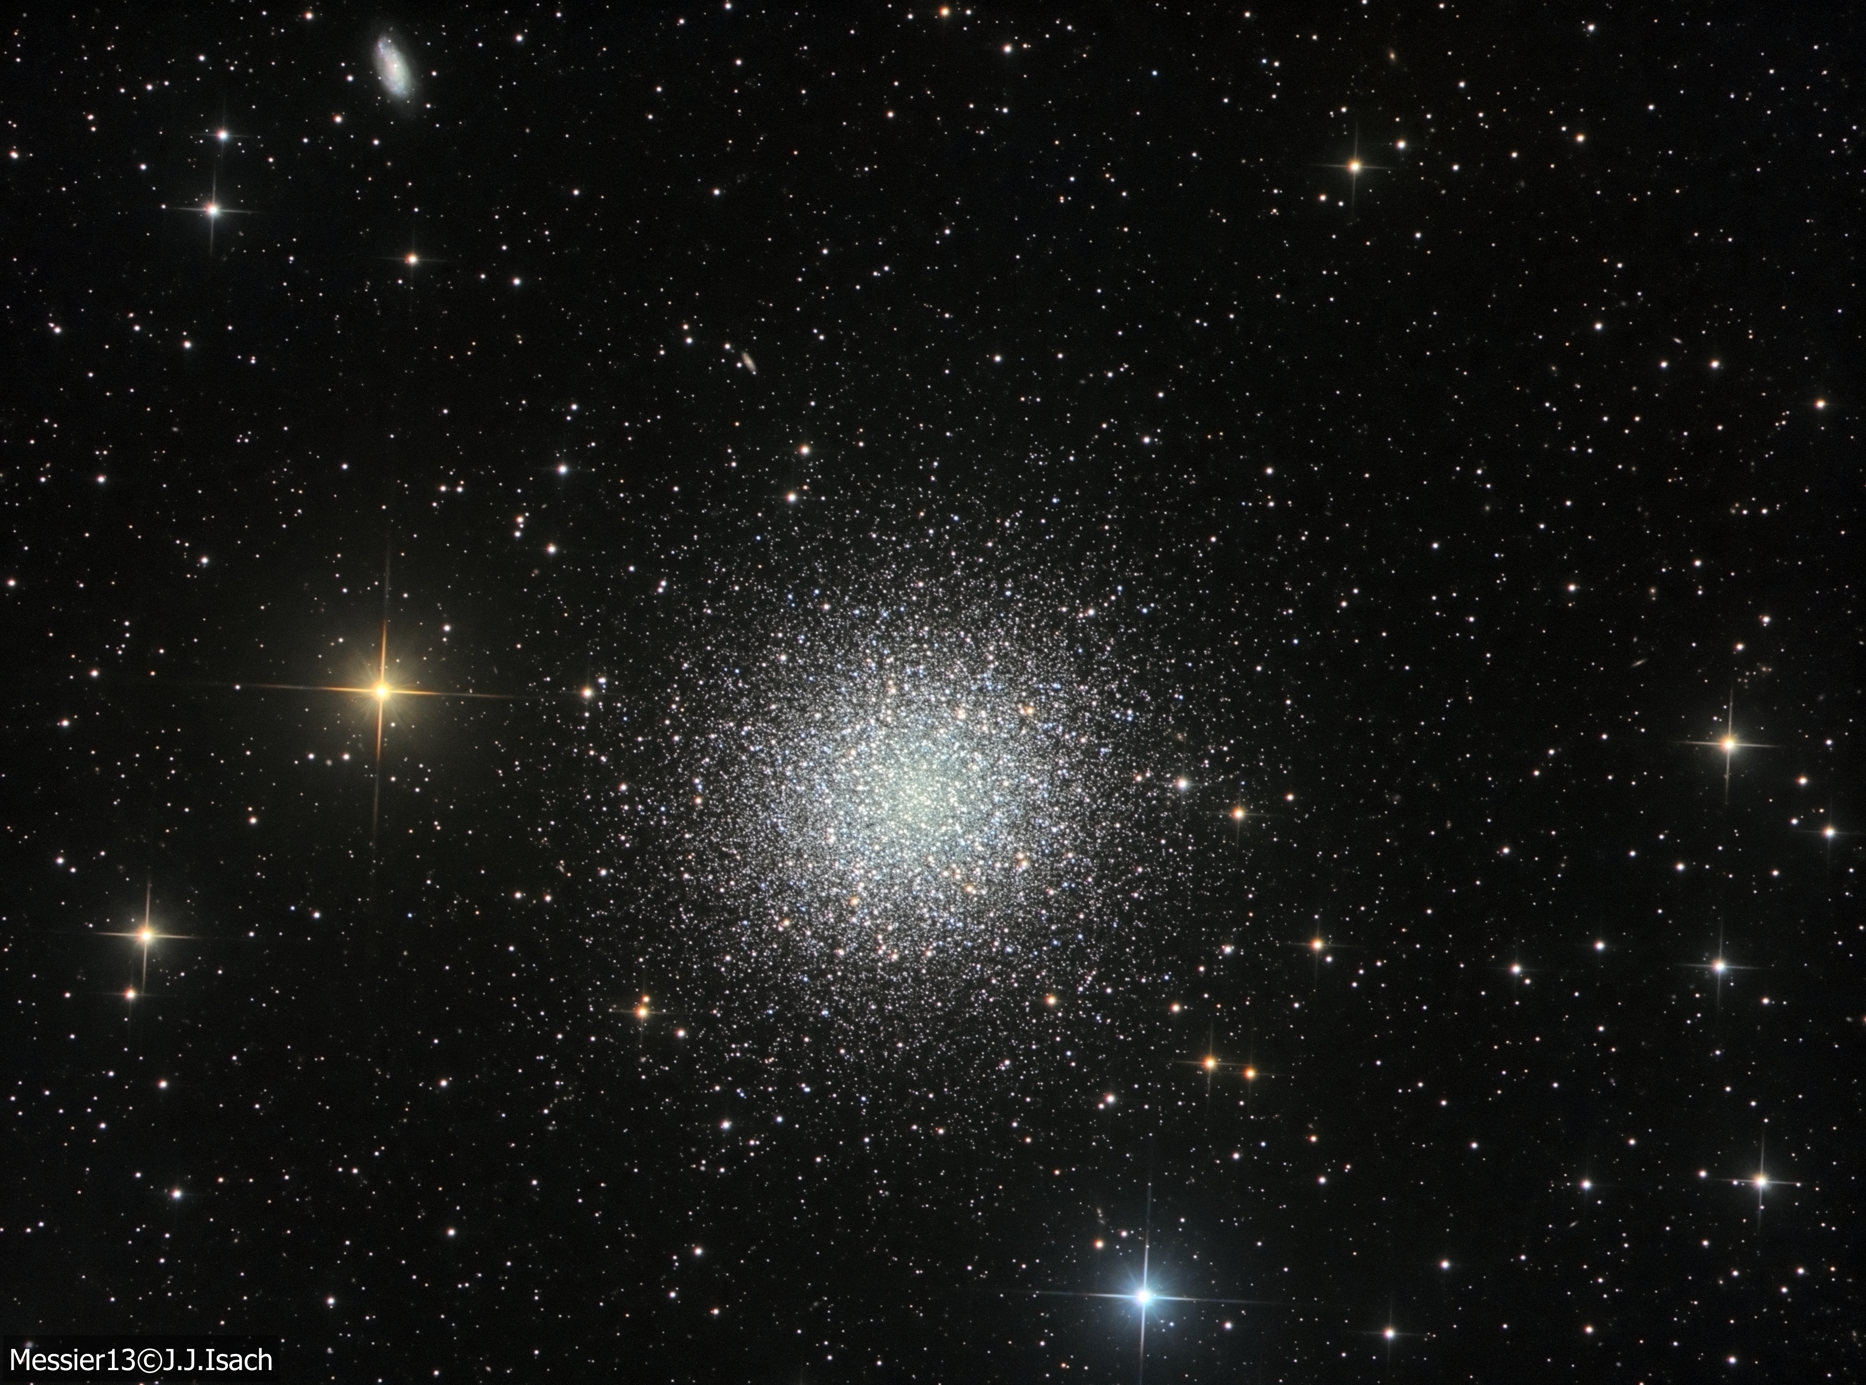
NGC 2141 and HR Diagram
Presentor: Trang Huynh

Slide 2
Introduction
Objectives: to identify stars in the globular cluster NGC 2141 and create H-R diagram using sigma clipping method and peak finding algorithm
4 main steps:
Measure stars’ photometry
Detecting stars
Segmenting stars
Creating HR diagram for NGC 2141

Slide 3
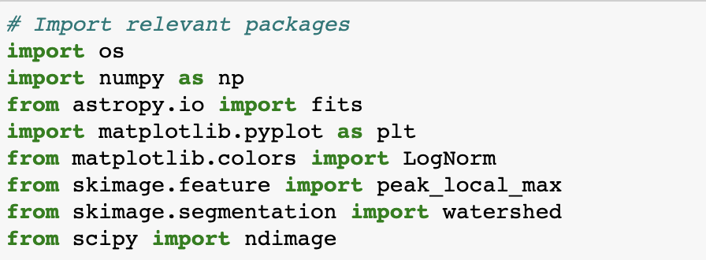
Data obtained from ASTR 4261: Observational Astronomy:
R filter: ngc2141_Mar28-003R.fit
V filter: ngc2141_Mar28-003V.fit

Slide 4
Adjusting parameters throughout the code:
minRadius - stars that are a certain minimum radius away from the center
threshold - number of standard deviations above the background; low value of threshold will pick up most stars; but leads to possible false detections
minSNRatio - minimum signal to noiseratio (S/N) of a star for it to be included in HR diagram. S/N is a flux count (S) divided by the uncertainty in their count (N)
$$N=\sqrt{S+N_{pix}σ_{bg}^{2}}$$

Slide 5
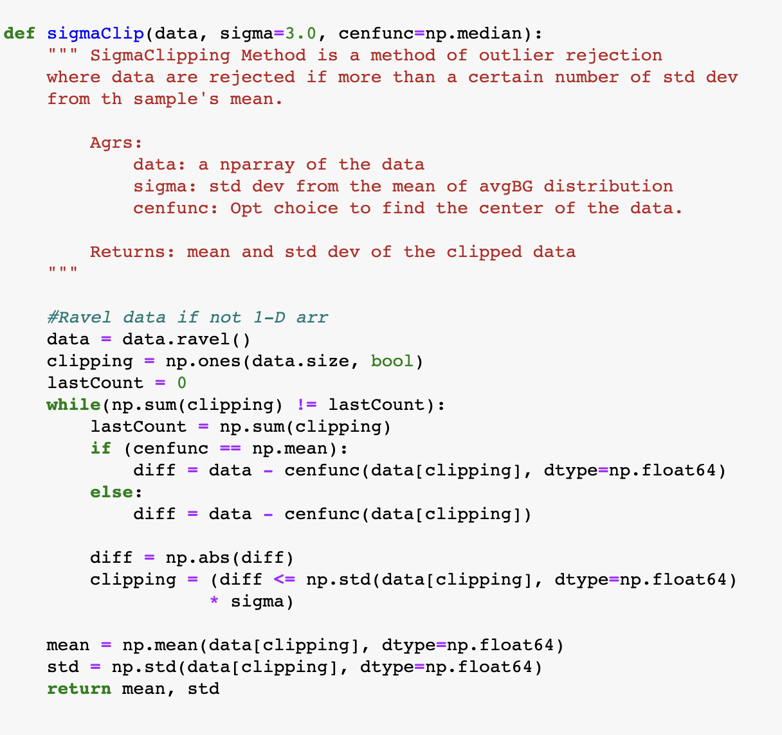
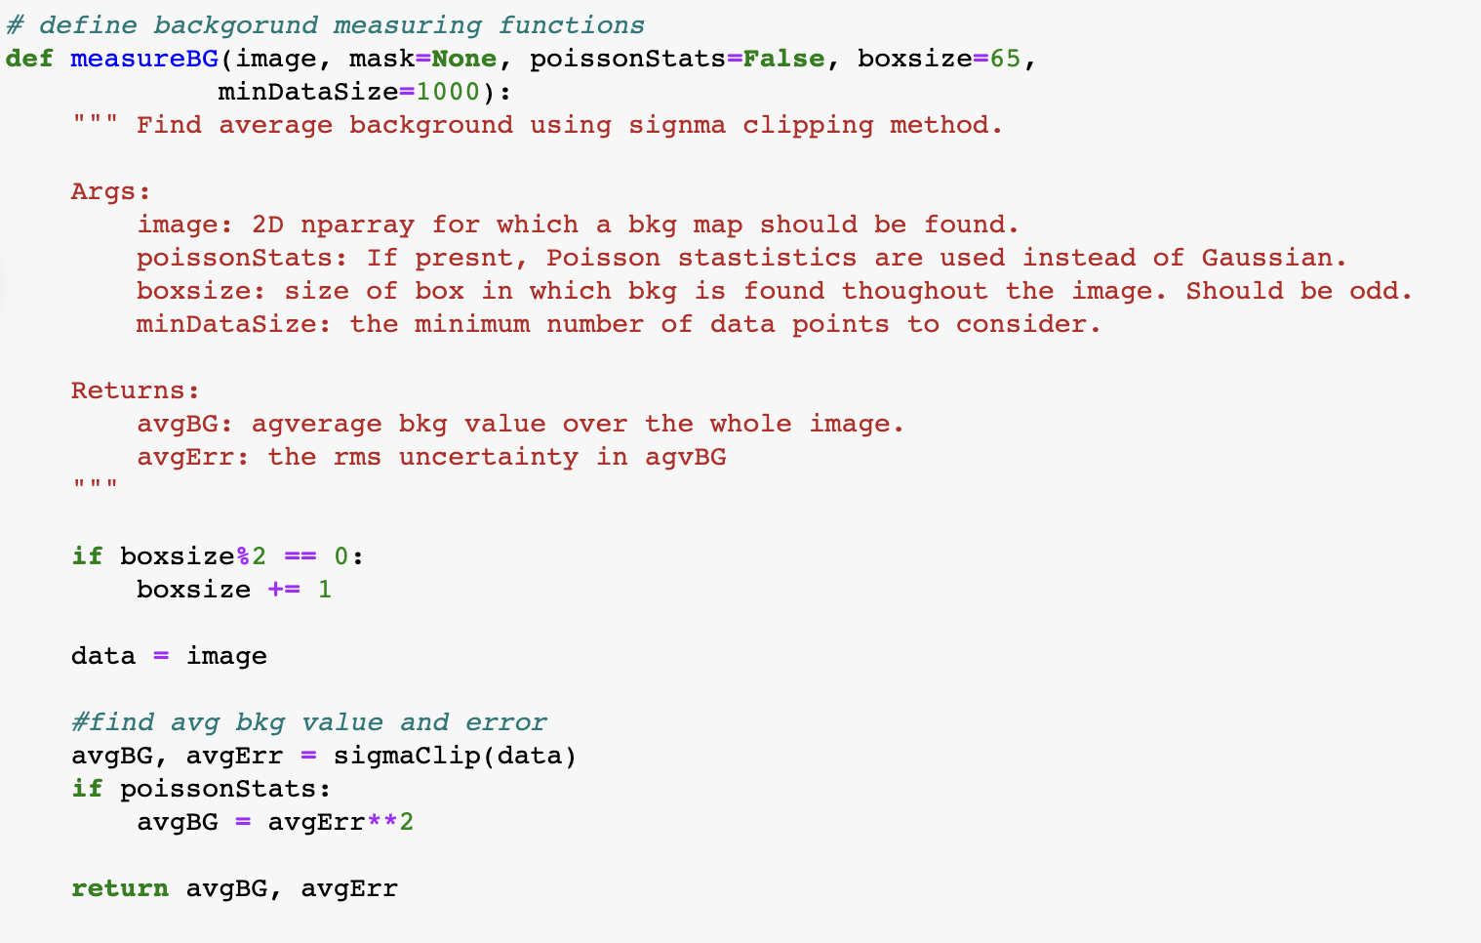
Step 1: Measuring Stars’ Photometry
Using SigmaClipping Method
Ref: https://www.kaggle.com/code/robertsorba/globular-cluster/notebook

Slide 6
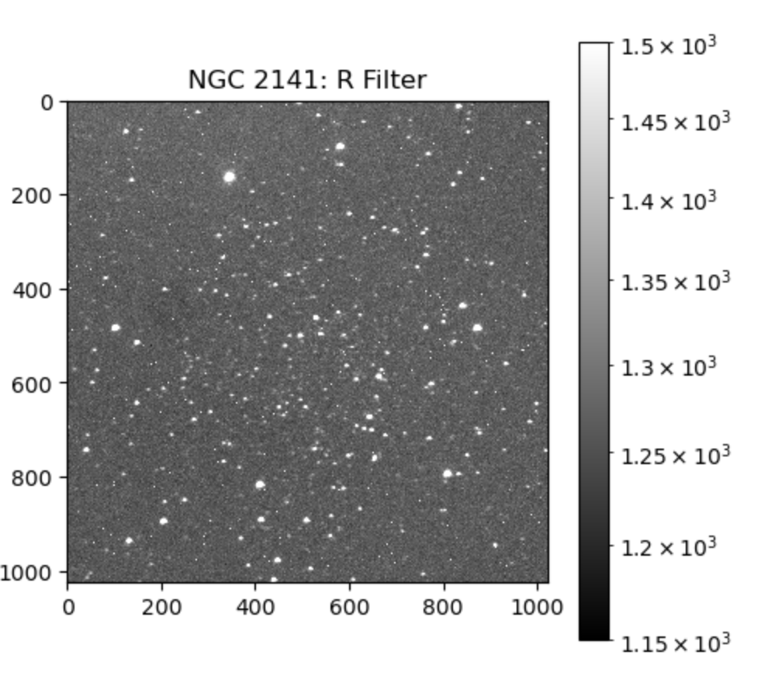
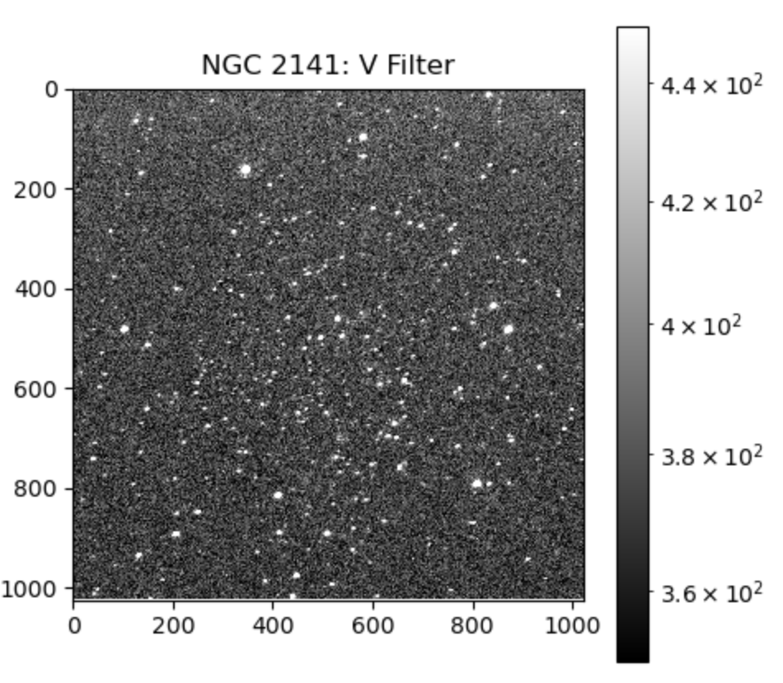
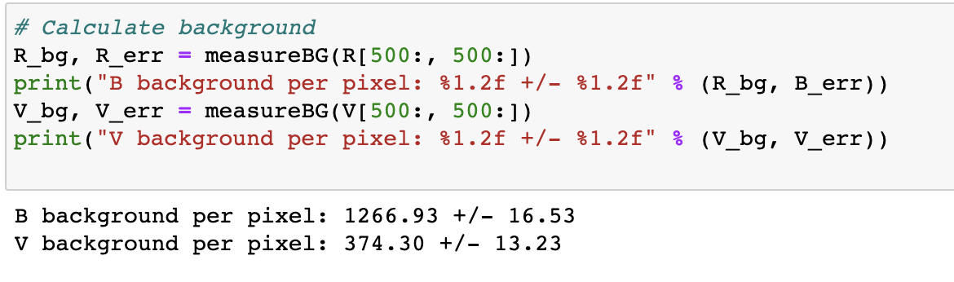

Slide 7
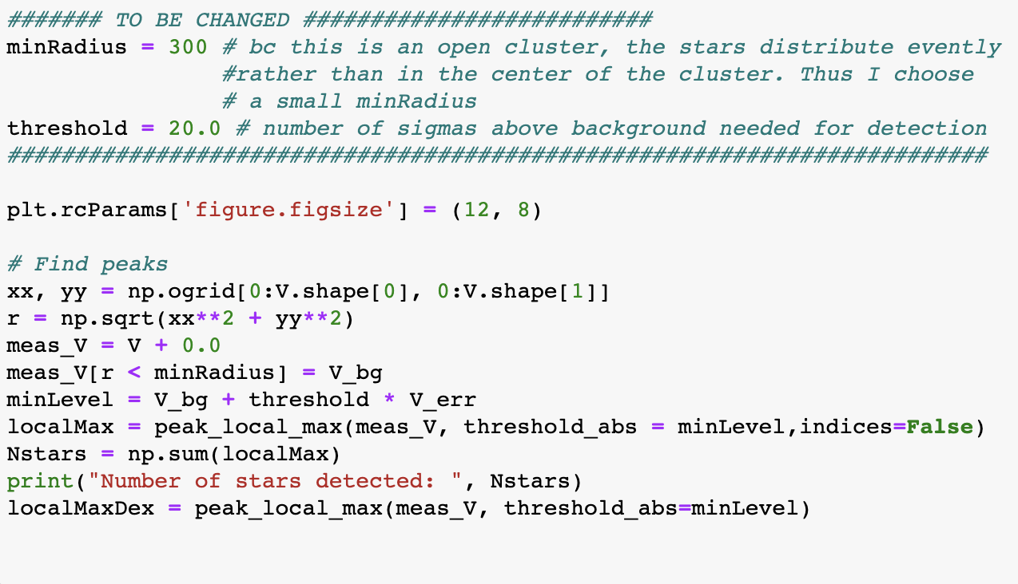
Step 2: Detecting Stars
Calculate the coordinates of stars in V filter
Calculate minimum random noise
Picked out peaks that are above 20 sigma

Slide 8
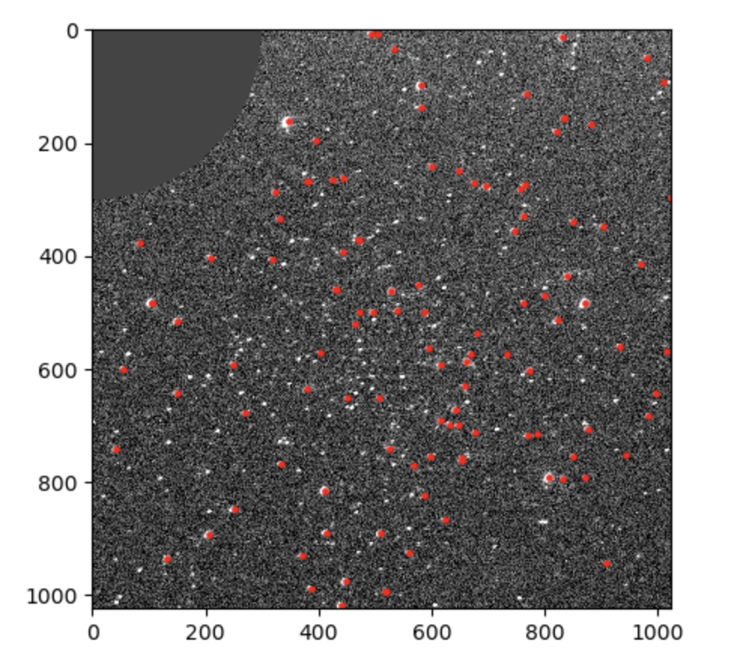
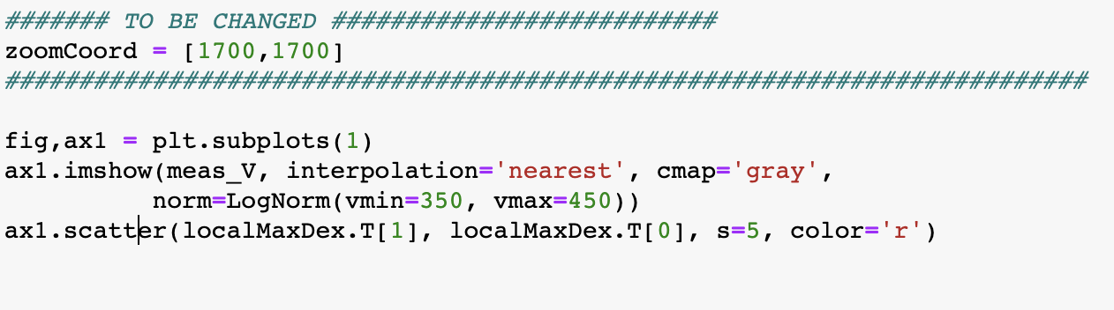
Identify 112 stars that are 300 pixels away from the center with 20 sigma above the background

Slide 9
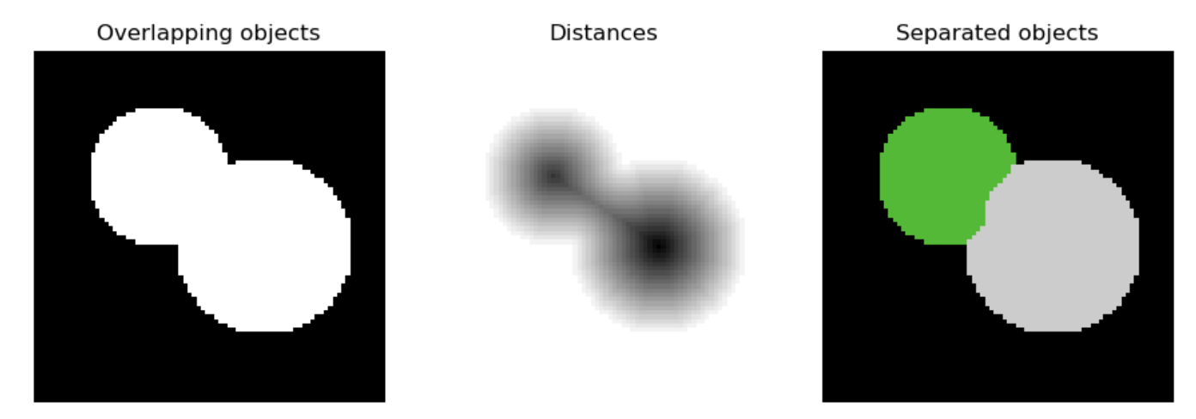
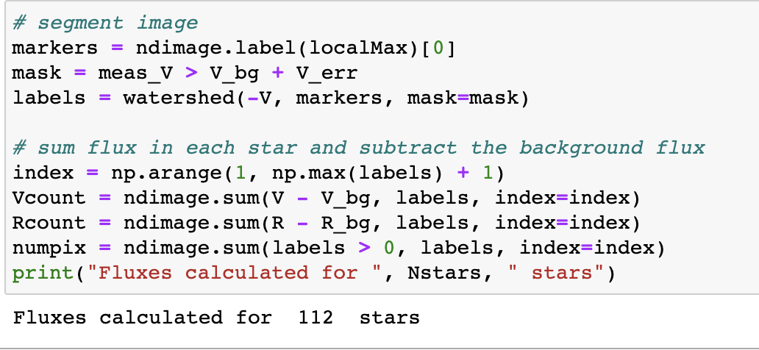
Step 3: Segmenting Stars
Use watershed algorithm to determine the detected stars’ pixels by separating 2 stars that have overlapping fluxes.
Markers: maximum of the distance between the star and background
Determine the total flux of each star by summing up al fluxes and subtracting the background

Slide 10
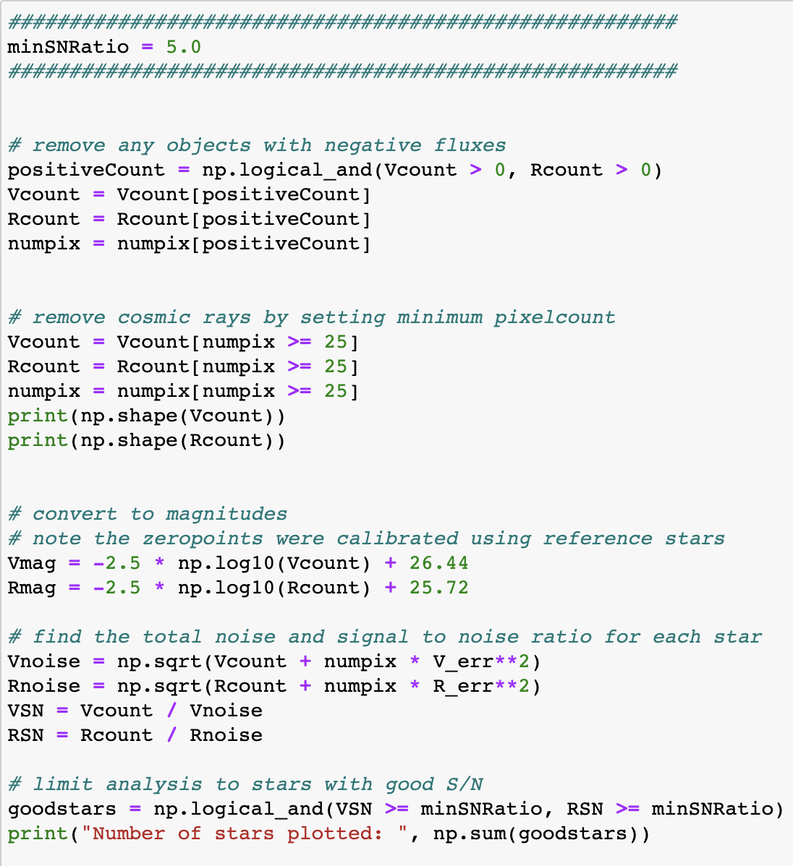
Step 4: Creating H-R Diagram
Perform further refinement to exclude false detections of stars
Poisson Statistics
S/N = flux count / unc
$$N=\sqrt{S+N_{pix}σ_{bg}^{2}}$$

Slide 11
